Slide 1




WordPress Themes
Install and Configure WP Themes
Popular WP Themes. Visual Editors
WordPress
Themes
SoftUni Team
Technical Trainers
Software University
http://softuni.bg

Slide 2



Table of Contents
Install and Configure WP Themes
Configuring Header / Footer, Menus, Sidebar Widgets, …
Popular WP Themes
WordPress.org Theme Directory
Sydney, Hestia, Journal, Total, Event
ThemeForest Directory (Paid)
Visual Editors for WordPress
Using Page Builder and Elementor

Slide 3
Have a Question?
sli.do #web-basics

Slide 4

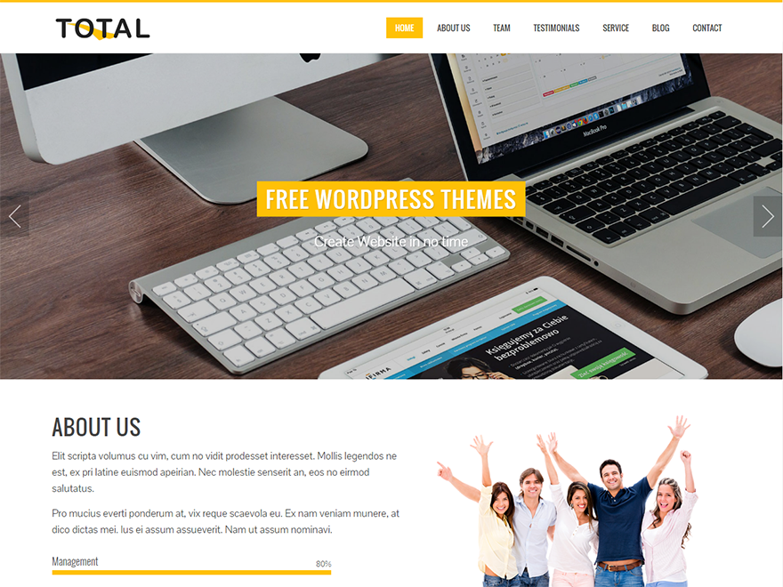
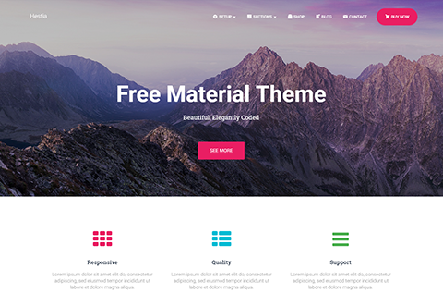




WordPress
Overview

Slide 5

What is a WordPress Theme?
WordPress themes
Change the design of your website
Change of the site layout / fonts / colors
Free themes – wordpress.org/themes
Less functionality, more effort to customize
Paid WP themes
Rich functionality, customizations, support
themeforest.net, colorlib.com, templatemonster.com, athemes.com

Slide 6
WP Themes
Install and Configure

Slide 7
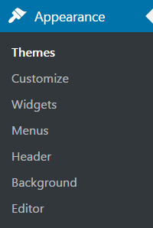
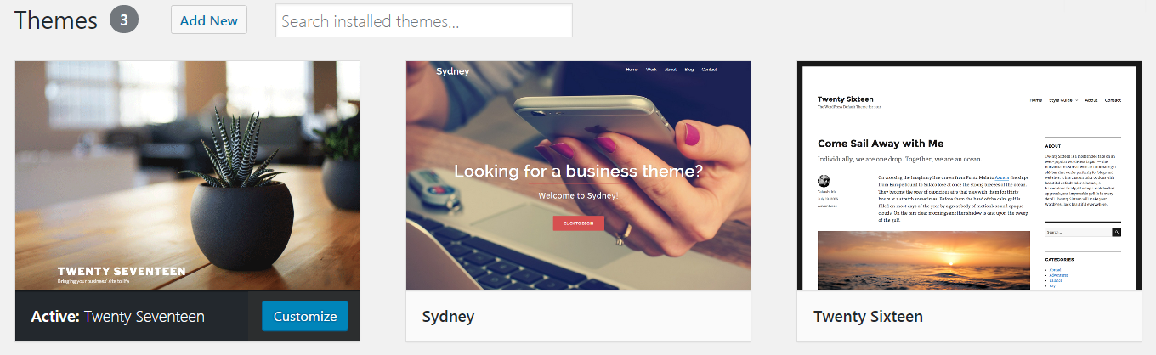
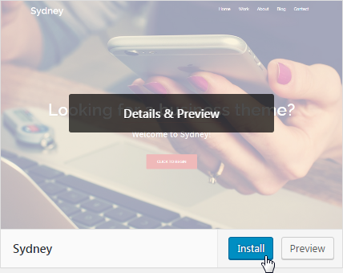
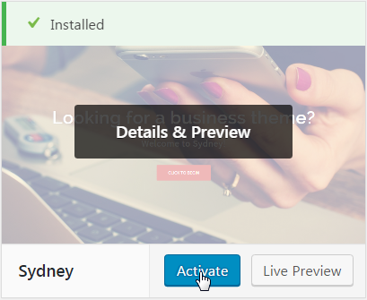
How to Install WP Theme?
Install themes from the WordPress.org theme directory

Slide 8
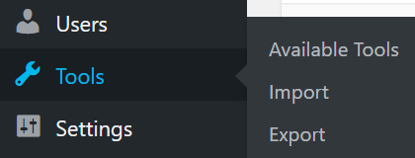
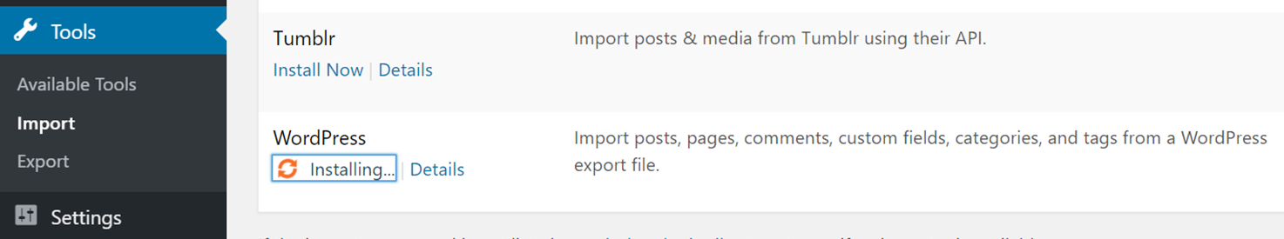
Fill Sample Content
Find demo content for your theme:
E.g. search in Internet for "Sydney WP theme demo content"
E.g. https://athemes.com/download/sydney-demo-content/
Import the demo content XML from the WordPress Importer
Download and import file attachments

Slide 9


Install Theme by ZIP Archive
Upload a ZIP archive holding a WP theme

Slide 10
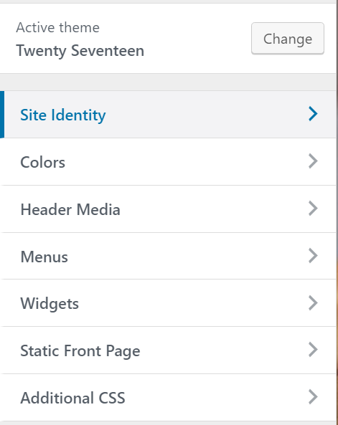
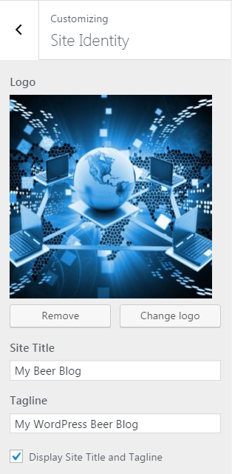

Customizing a Theme
Site Identity

Slide 11
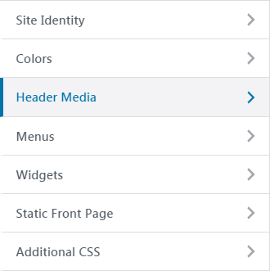
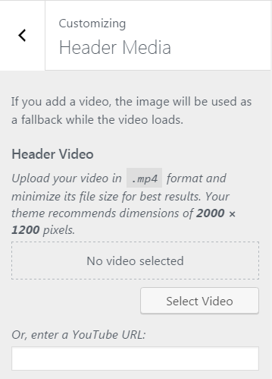
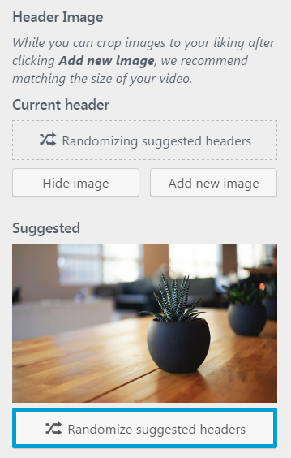
Customizing the Header and Footer
Header images / videos / sliders

Slide 12
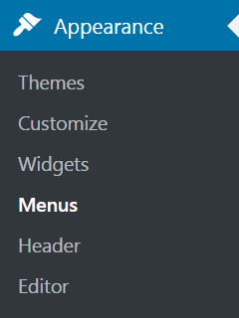
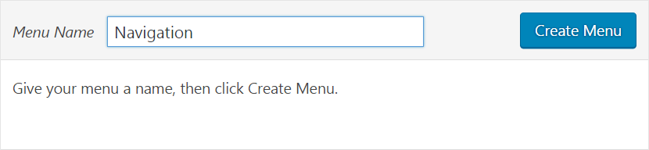
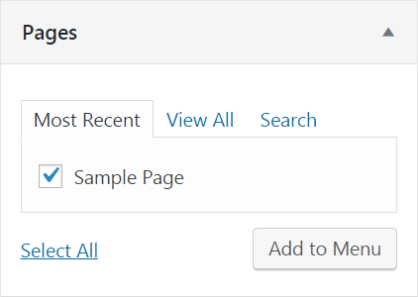
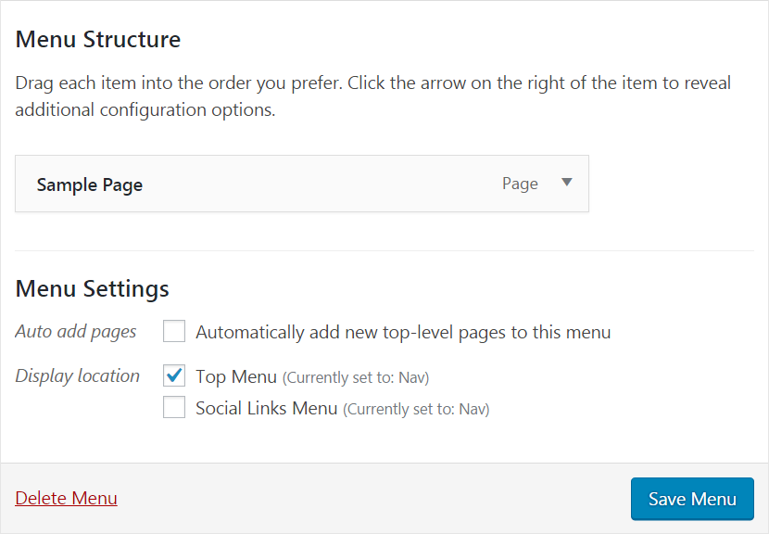
Customizing the Menus
Creating / editing menus in WordPress

Slide 13
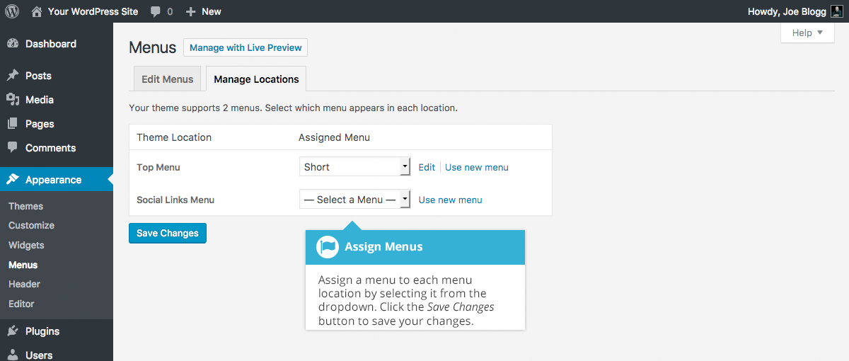
Customizing the Top Menu

Slide 14
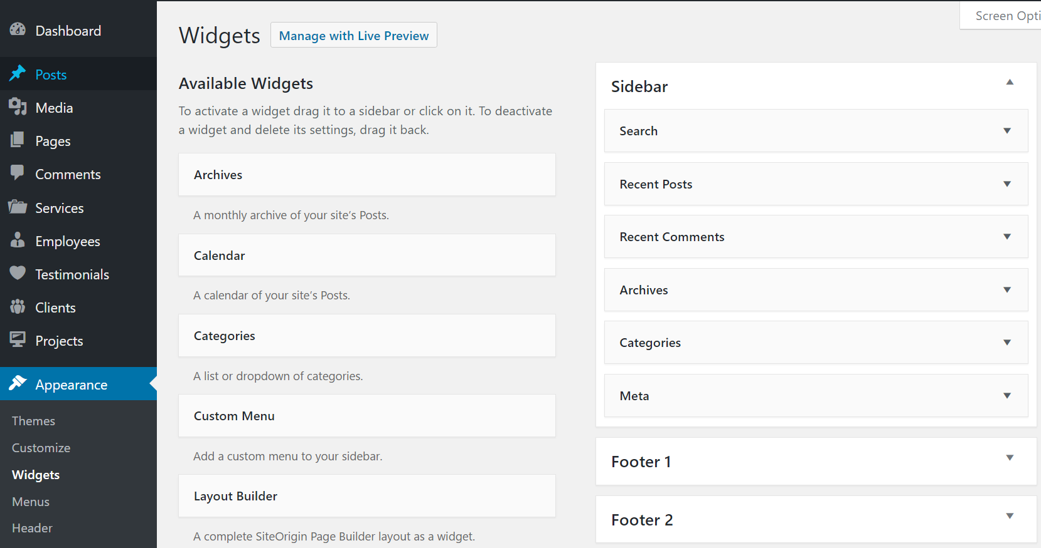
Customizing the Sidebar Widgets

Slide 15
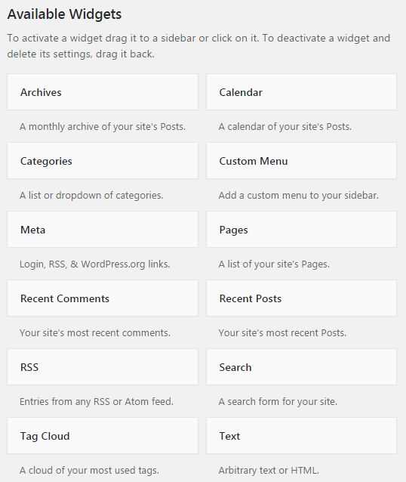
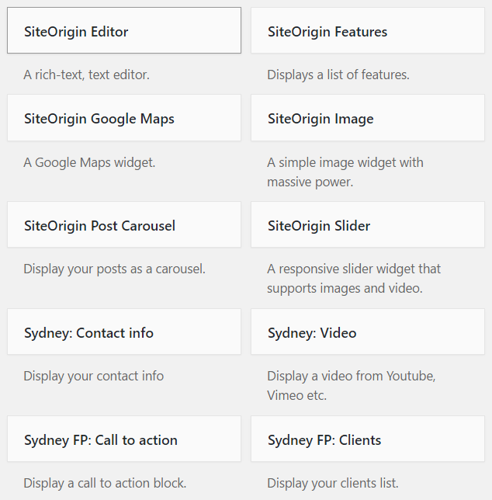
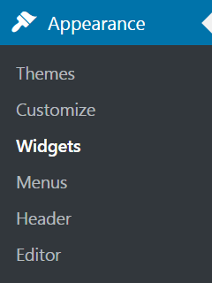
Standard Widgets, Theme Widgets, Plugin Widgets

Slide 16
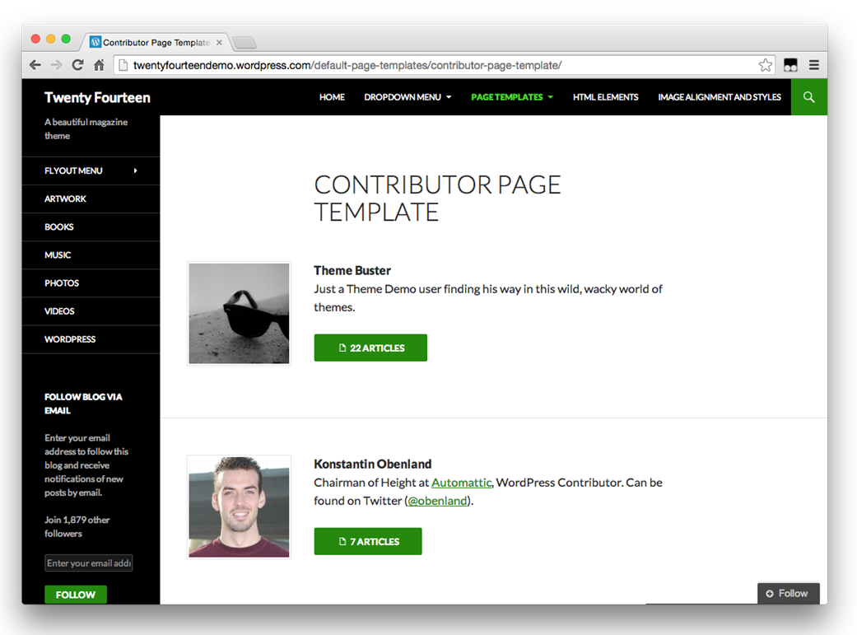
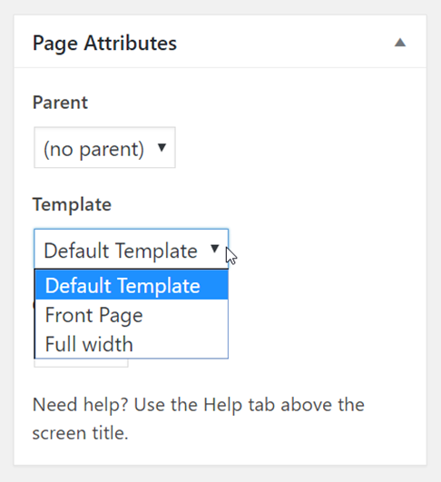
Theme Templates
Page template changes the page layout

Slide 17

Popular WP Themes
Sydney, Hestia, Journal, Total, Event

Slide 18
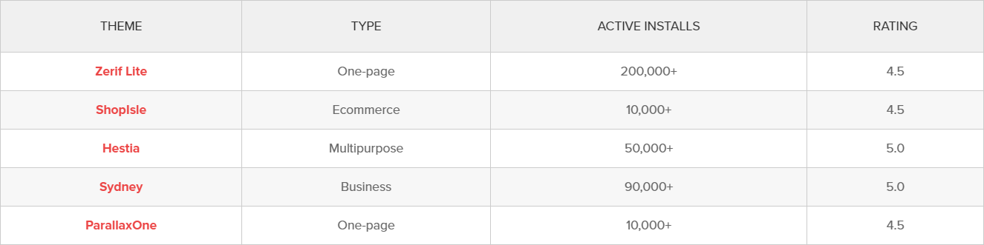
Standard Themes
Top 5 best free WordPress themes (2017)
Source: https://www.codeinwp.com/blog/best-free-wordpress-themes/

Slide 19

Sydney
Sydney == free general business WP theme
https://athemes.com/theme/sydney/
Features:
Responsive layout
Parallax backgrounds
Slider / image header
Social links
Works with page builders

Slide 20

Hestia
Hestia == free material design WP theme
https://themeisle.com/themes/hestia/
Features:
Responsive design
Google material design
Widgetized footer
Live customizer
Works with page builders

Slide 21
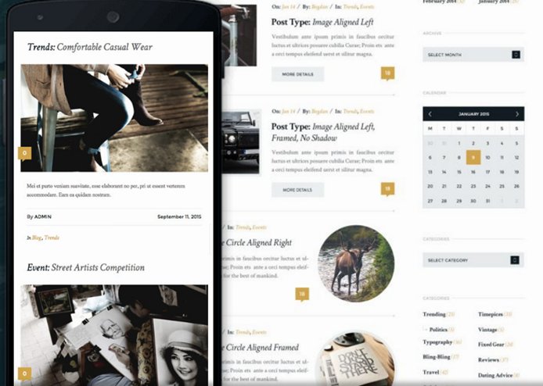
Journal
Journal == free blog / magazine WP theme
https://themefuse.com/wp-themes-shop/journal/
Features:
Responsive design
Multiple layouts
Highly customizable
Visual page builder

Slide 22
Total
Total == free general purpose WP theme
https://hashthemes.com/wordpress-theme/total/
Features:
Responsive design
Multiple layouts
Home page, blog, portfolio
Build-in slider
Highly customizable

Slide 23

Event
Event == free WP theme for conferences / events
https://wordpress.org/themes/event/
Features:
Responsive design
Slider, gallery, schedule, speakers, sponsors, events
Multiple blog layouts
Social media integrations

Slide 24

Pinboard
Pinboard == nice looking free WP theme for blogs and sites
https://wordpress.org/themes/pinboard/
http://demo.onedesigns.com/pinboard/
Multiple page layouts
Built-in photo gallery

Slide 25
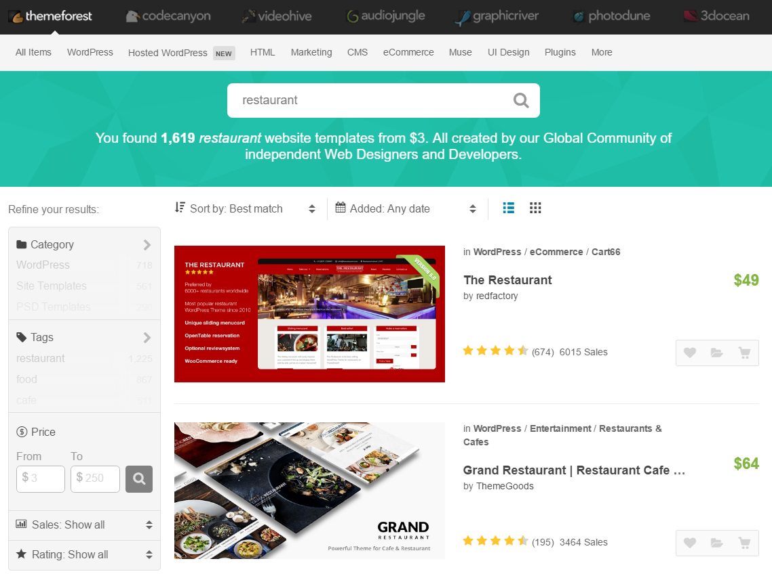
Paid WordPress Themes
ThemeForest
The largest commercial WP theme directory
https://themeforest.net
ColorLib
https://colorlib.com/wp/free-wordpress-themes/
TemplateMonster
https://www.templatemonster.com/wordpress-themes.php

Slide 26

Practice: Install & Customize Themes
Install "Sydney" free WP theme
Import demo content
Change the home page texts + slider
Change the top menu (add pages)
Change the sidebar + footer widgets
Live Exercises in Class (Lab)

Slide 27
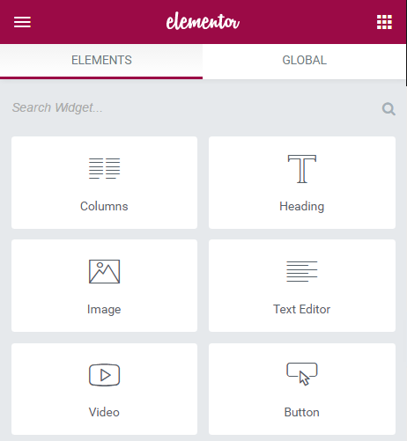
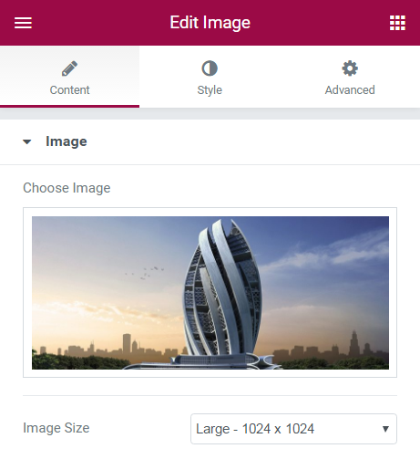
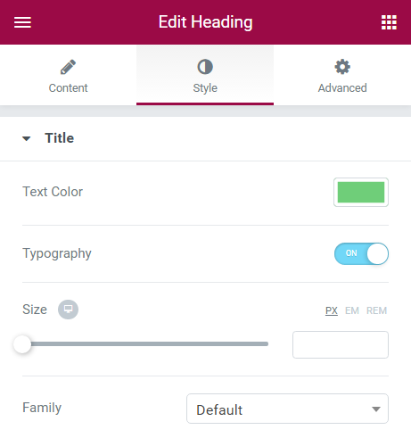
Visual Editors for WordPress
Page Builder and Elementor

Slide 28
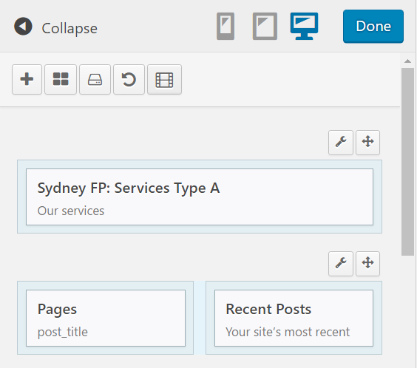
Page Builder (by Site Origin)
Site Origin Page Builder
Free visual page editor
1 million+ active installs
https://siteorigin.com/page-builder/
Layout consists of rows, holding columns
Columns hold widgets

Slide 29
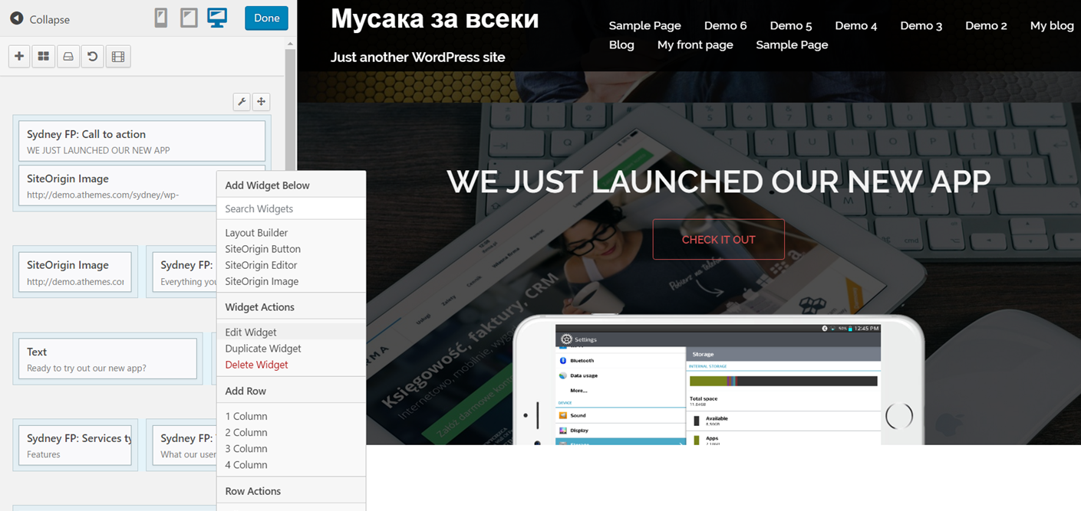
Building Pages with Page Builder
Live Demo

Slide 30
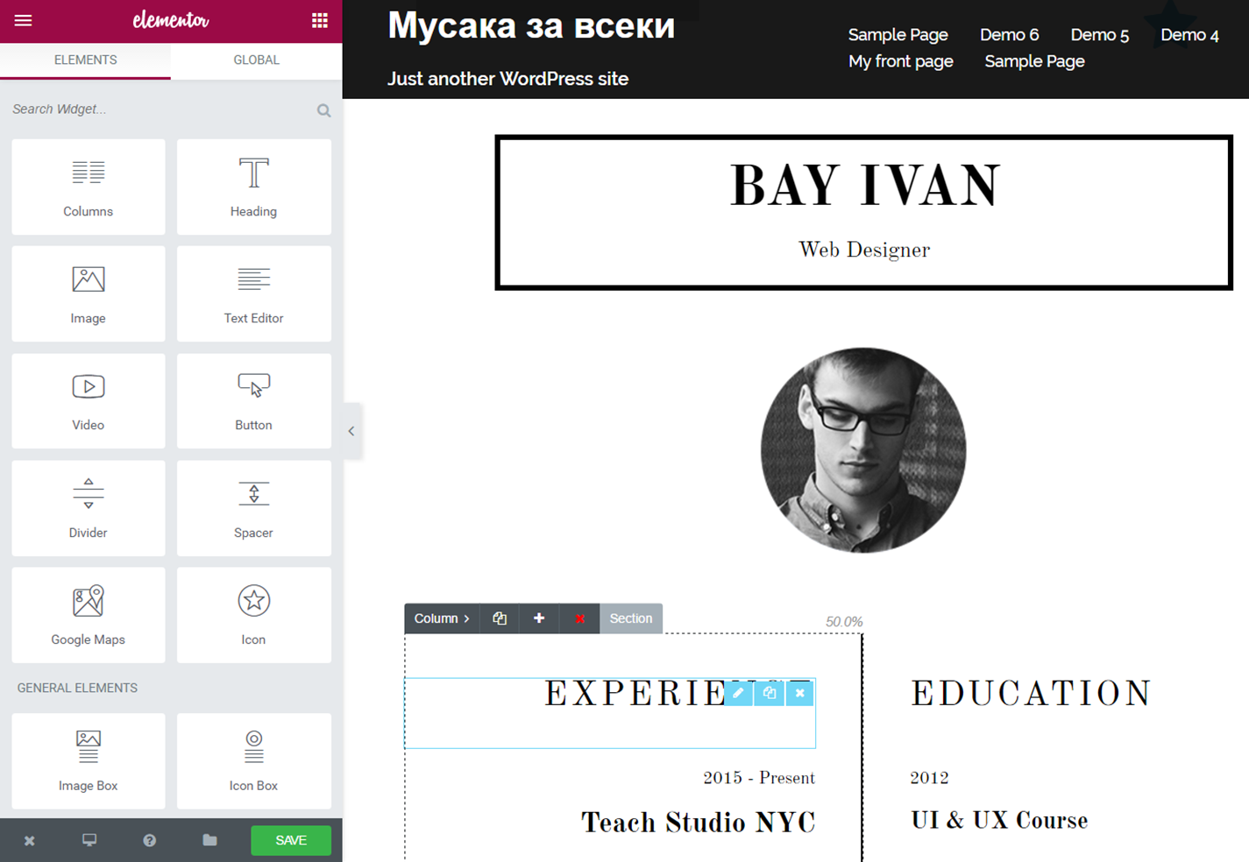
Elementor Live Page Builder
Elementor
Powerful, free live page editor for WP
80,000+ active installs
https://elementor.com
Layout consists of sections, holding columns
Columns hold widgets

Slide 31
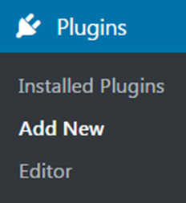
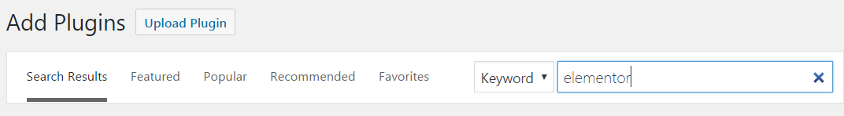
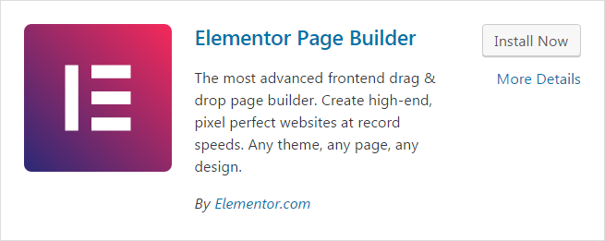
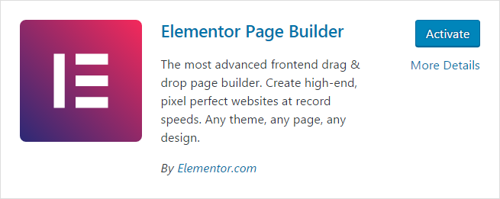
Elementor
Install Elementor WP plugin

Slide 32
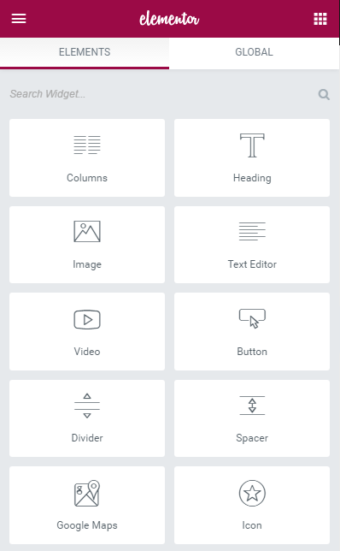

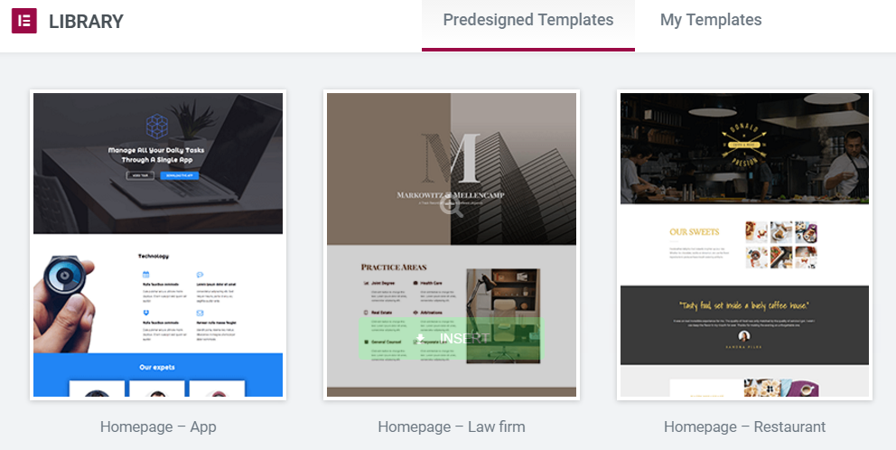
Building Pages with Elementor
Section – block of page holding columns, each holding widgets

Slide 33
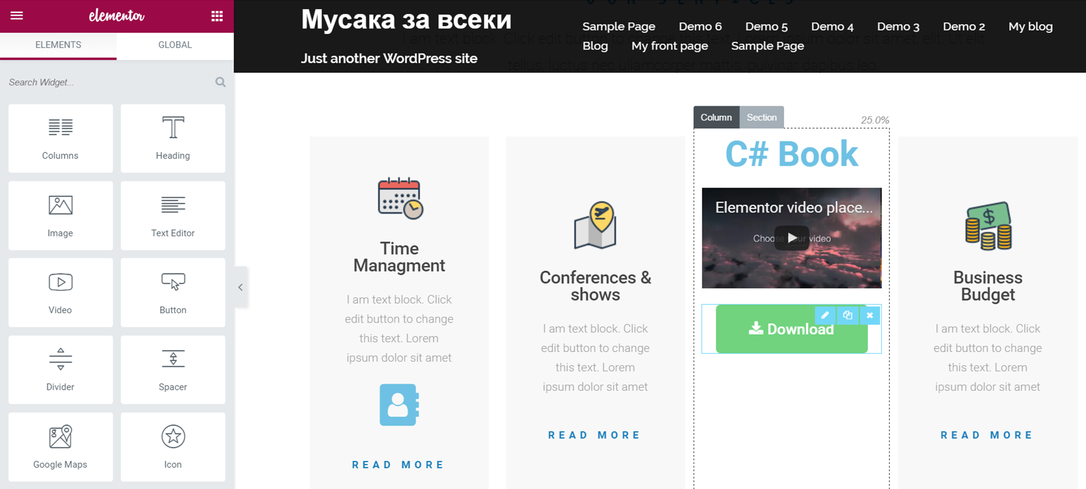
Building Pages with Elementor
Live Demo

Slide 34
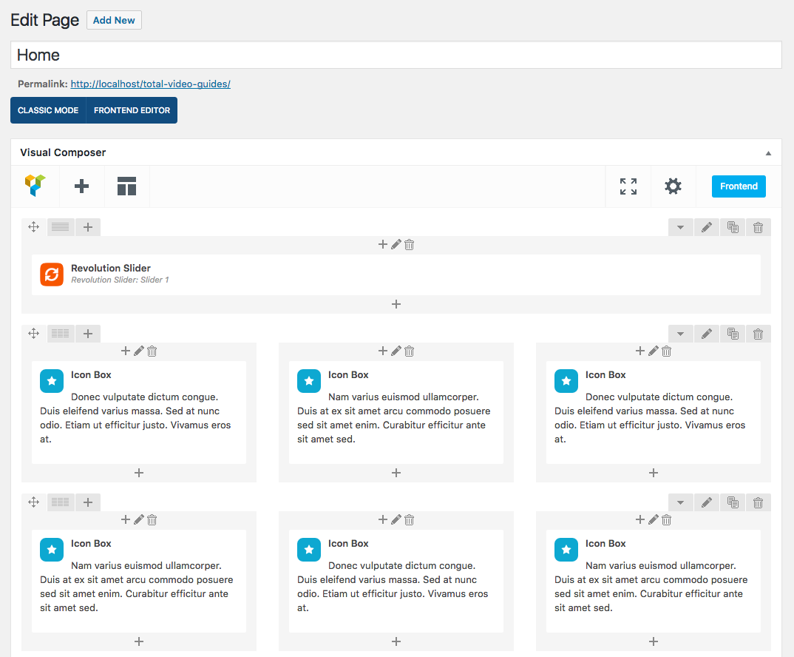
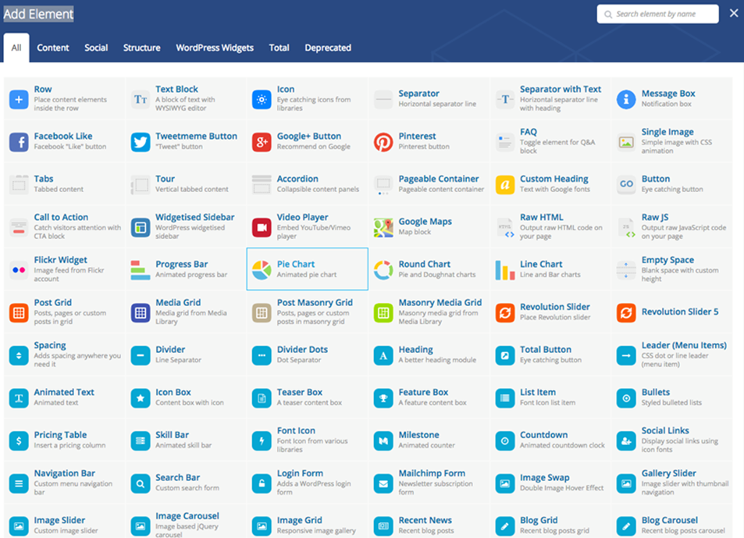
Paid Page Builders for WP
Visual Composer (paid page builder) – https://vc.wpbakery.com

Slide 35
Practice: Elementor Page Builder
Install "Elementor" page builder
Create a "CV" page by the using the CV predesigned template
Create a "Contact" page by the using the "Contact – Hotel" template
Live Exercises in Class (Lab)

Slide 36

Summary
WordPress themes provide
Layout, functionality and look and feel for your WP site
Popular free themes: Sydney, Hestia, Journal, Total, Event
Paid themes: https://themeforest.net
Page Builder (by SiteOrigin)
Simple page builder: rows, columns, widgets
Elementor live page builder
Powerful UI builder: sections, columns, widgets

Slide 37







WordPress Themes
https://softuni.bg/courses/wordpress-basics

Slide 38

License
This course (slides, examples, demos, videos, homework, etc.) is licensed under the "Creative Commons Attribution-NonCommercial-ShareAlike 4.0 International" license

Slide 39





Free Trainings @ Software University
Software University – High-Quality Education, Profession and Job for Software Developers
softuni.bg
Software University Foundation
softuni.org
Software University @ Facebook
facebook.com/SoftwareUniversity
Software University Forums
softuni.bg/forum

